Slide 1
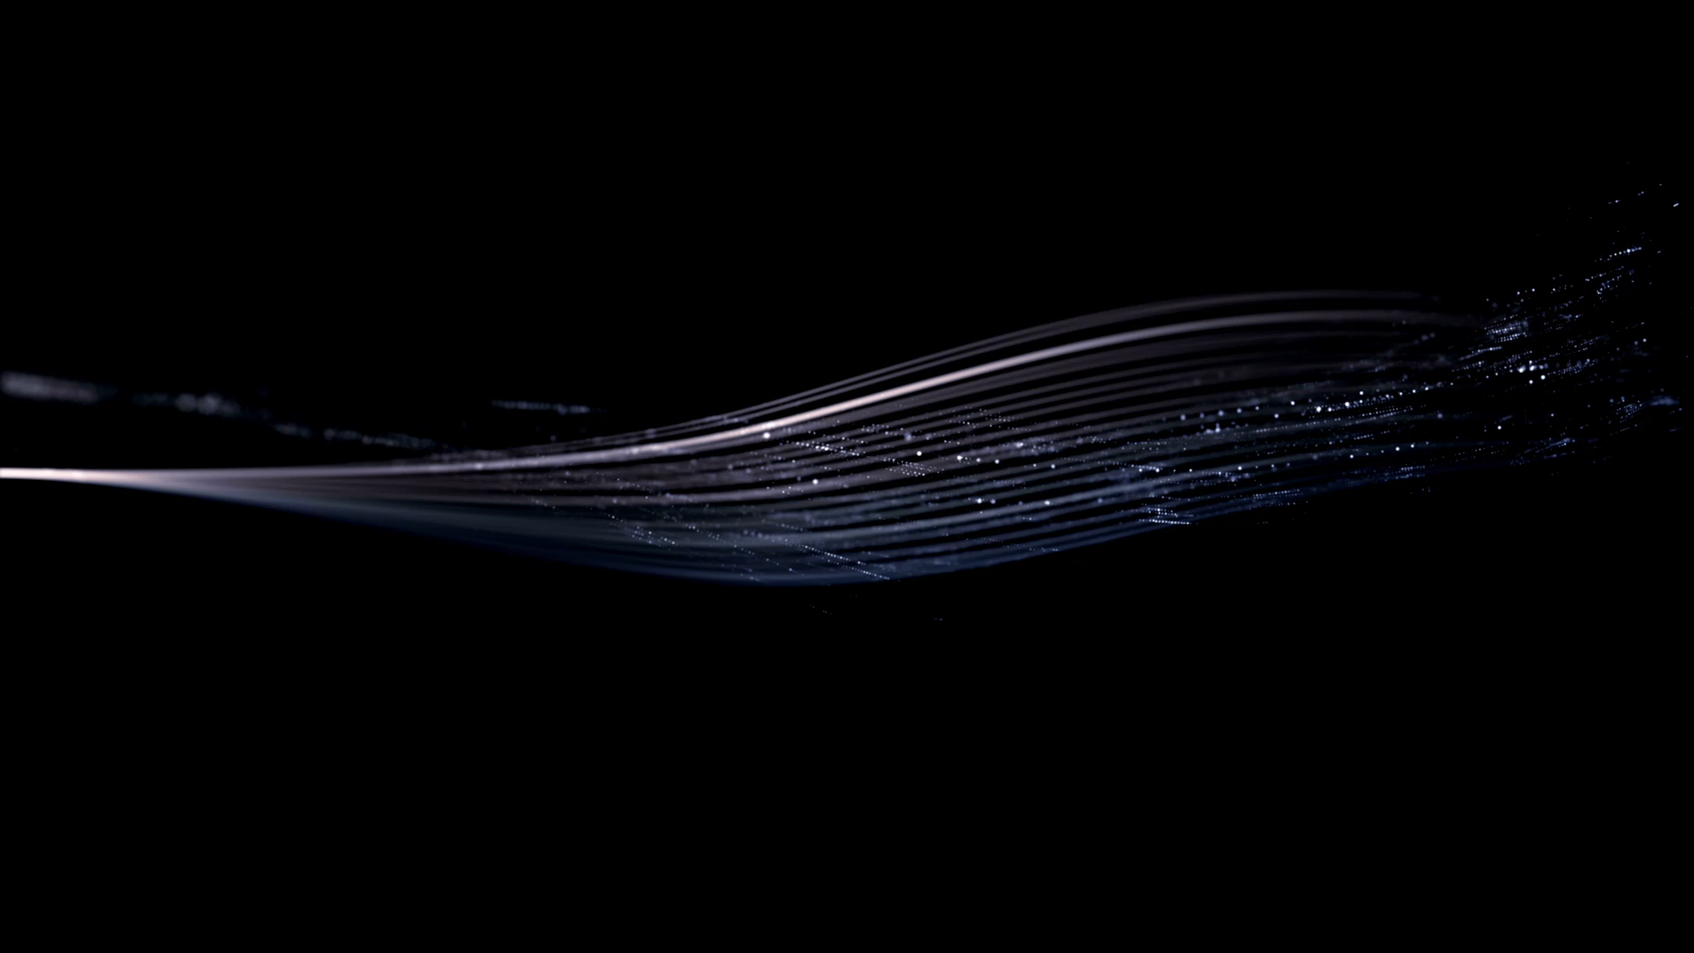
Ferroresonance
Isaac Hoese

Slide 2
Ferroresonance VS Resonance
Non-linear
No definite resonating frequency
Notes:
To obtain a basic understanding of Ferroresonance, it is important to see the difference between Ferroresonance and common resonance. First off, Ferroresonance is non-linear in nature. This is a result of the transformer’s iron core that has non-linear characteristics. This will be further discussed in a few slides in more detail. The second main difference is there is no definite resonating frequency. In normal resonance, there is one frequency that makes the equation omega L equal 1 over omega C true. When dealing with Ferroresonance, it is possible for there to be multiple steady state and transient responses.

Slide 3
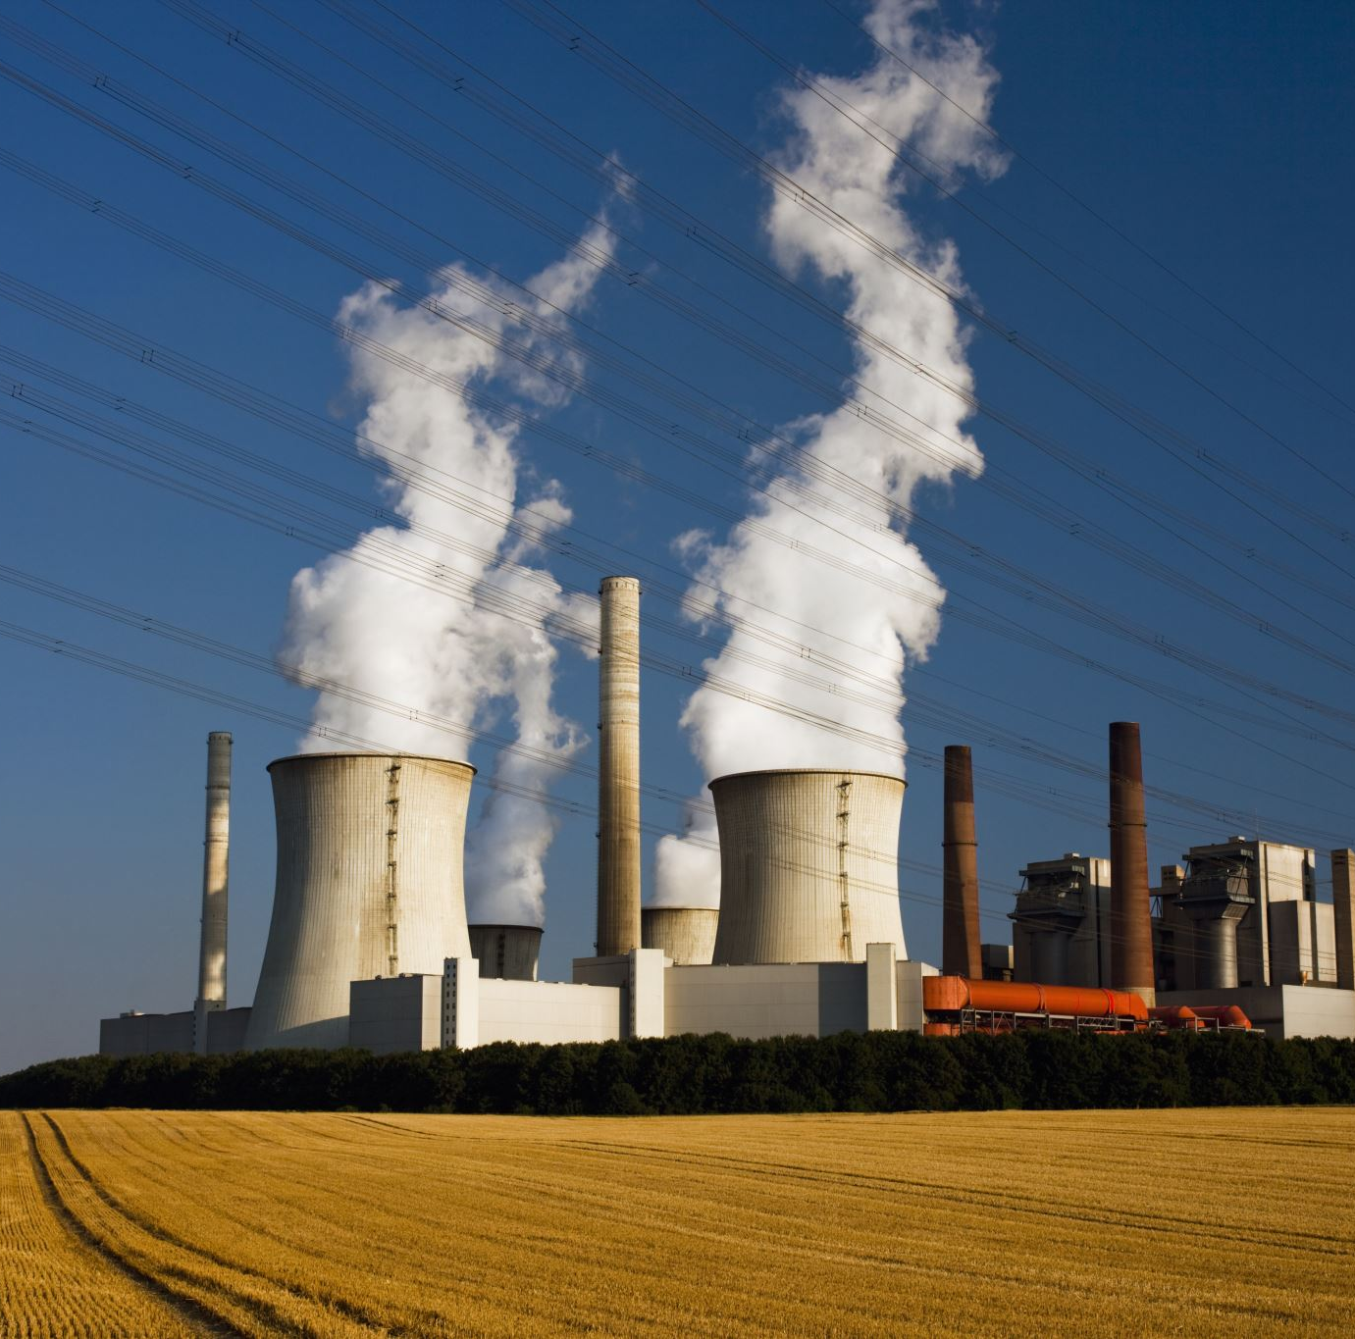
Occurrences
Power systems in voltages 25 kV or higher.
Single- or two-phase power is supplied to a three-phase transformer.
Notes:
Ferro resonance is most commonly seen in power systems in voltages 25 kV or higher, although it could occur as low as 12 kV if the conditions are extreme enough. Usually, a system has ferro resonance when there is a long underground tap with light load. It often occurs when a three phase transformer is supplied with one or two phases of power. This could be a result of switching, or a fault where a fuse blows. The magnetic flux of the transformer core does not cancel, which causes a non-linear form of inductance.

Slide 4

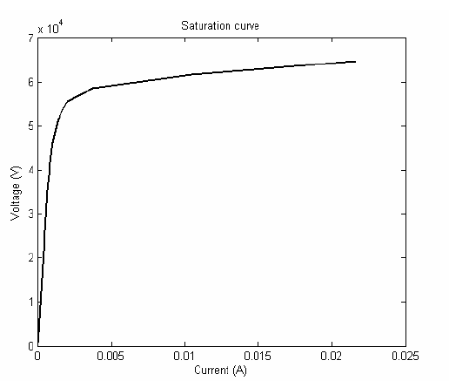
Transformer Saturation Curve
Notes:
The inductance of the system relies on the transformer saturation curve. The curve is combined of a linear region, a saturation region, and a knee region. The saturation region is a cause of real losses from the transformer windings and flux leakage. In an ideal transformer model, there would only be a linear region.

Slide 5
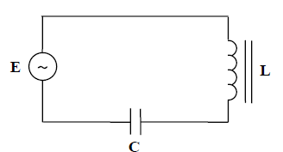
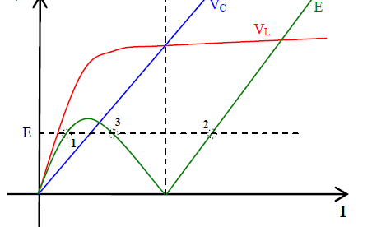
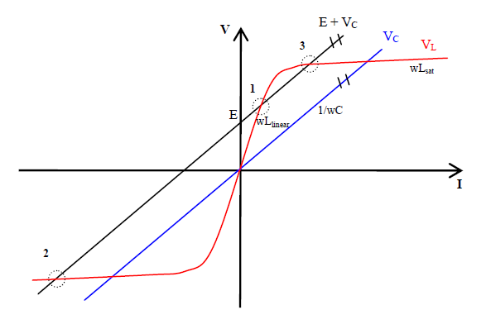
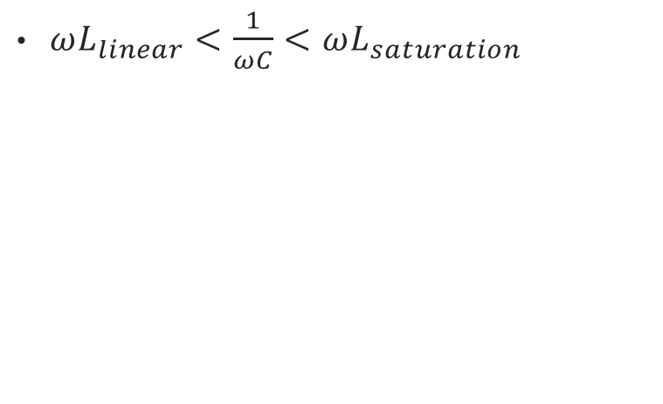
Graphical Representation
$ωL_{linear}<\frac{1}{ωC}<ωL_{saturation}$
Notes:
Here is the analysis of a series ferro – resonant circuit. Point 1 on the graphs is when the inductor voltage is greater than the capacitor voltage. This is considered stable because the inductance is in the linear region. Point two is when the capacitor voltage is greater than the inductor voltage. This is stable because the inductance is in the saturation region. Point three is when the inductive and capacitive reactances are equal, thus creating an extremely low impedance circuit. The point is at the knee region, so the inductance jumps between saturation and linear, which makes it highly unstable. This operating point can neve be reached, but it can be “passed through”. When the system passes through this point, it adds an extra current, which causes overvoltages. The maximum voltage loss when operating at point one is the voltage across the inductor. The largest voltage drop when at operating point two is across the capacitor. This is where the main problems of Ferroresonance are seen. The capacitance value in the circuit is represented

Slide 6
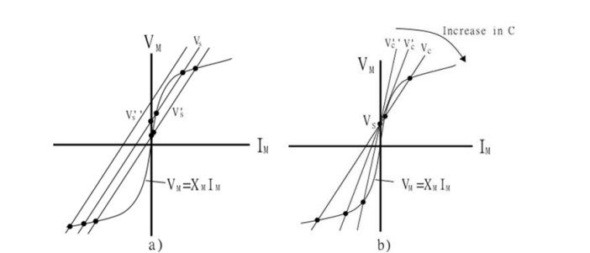
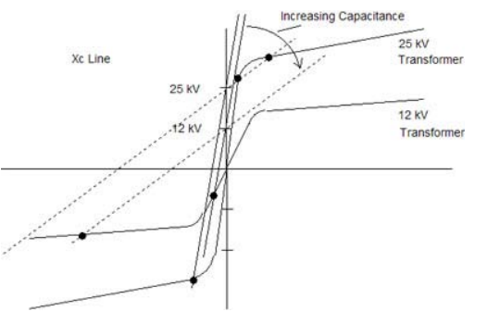
Dependencies
Changes in source voltage (a)
Changes in capacitance (b)
Bottom: EPRI Study
Notes:
Figure a shows the solutional changes when the source voltage is increased. As the voltage is increased, the stable non-ferroresonant solution dissipates, implying that an increase in voltage with the same conditions increases the likelihood of ferroresonance. Figure b shows the systems response to a change in capacitance. As the capacitance increases, the solutions convolves to one non ferro-resonant solution. This implies that for a given source voltage and transformer B-H saturation curve, there is a range of capacitance at which Ferroresonance is capable of occurring. The bottom figure was taken from an EPRI study. Their findings found that Ferroresonance was more likely at higher distribution voltages than lower ones. As you can see there is no intercept on the 12 kV transformer curve near the knee region, but there are two intercepts near the knee region for the 25 kV transformer.

Slide 7
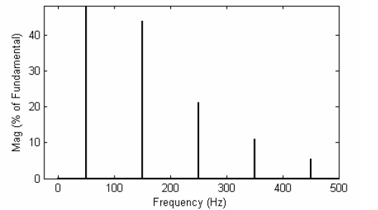
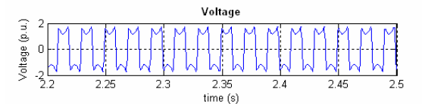
Fundamental Mode
Notes:
There are four main instances of ferro resonance. The fundamental mode shows currents and voltages acting periodically with the fundamental frequency and harmonics being active. The voltage and current waveforms are slightly distorted.

Slide 8
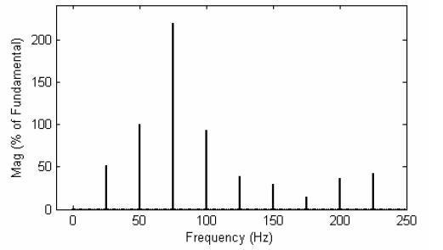
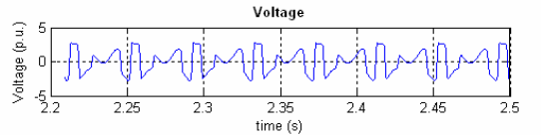
Subharmonic Mode
Notes:
Like the fundamental mode, the subharmonic mode has waveforms that repeat periodically. The harmonics of the system distort the voltage waveform. The harmonics are spaced out n times the fundamental frequency. In this case, the n value would be 0.5 because the fundamental frequency is 50 hz, and there is a harmonic every 25 hz.

Slide 9
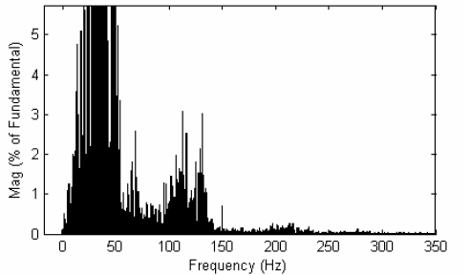
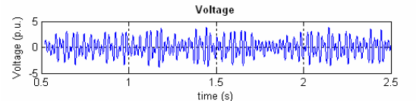
Chaotic Mode
Notes:
The waveform is completely random in chaotic mode. There have been no reports of chaotic mode occurring in ultra-high voltage substations and the only potential for chaotic mode to happen in voltage transformers was under highly unrealistic scenarios.

Slide 10
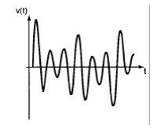
Quasi-Periodic Mode
Notes:
The quasi-periodic mode has an incoherence when looking at frequency spectrum. The formations go from one frequency to another, thus making the waveform aperiodic. The peaks of the waveform are not as distorted as previous modes.

Slide 11
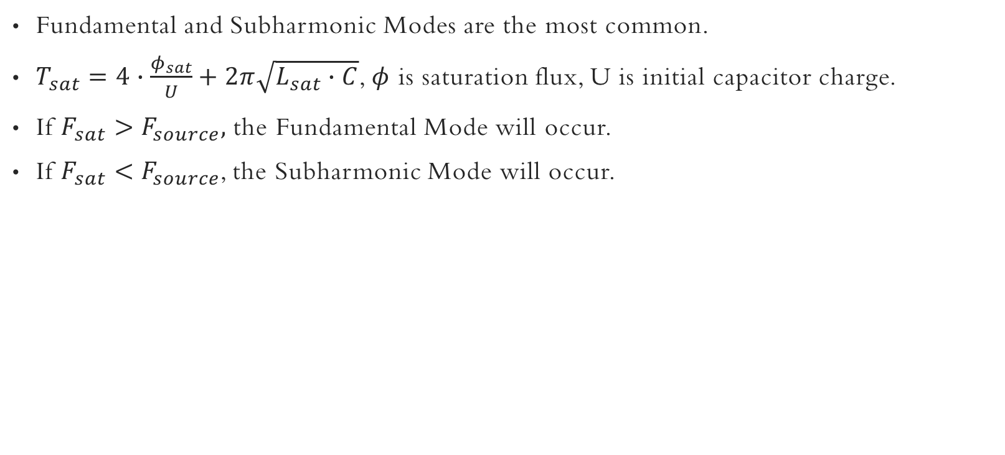
Common modes
Fundamental and Subharmonic Modes are the most common.
$T_{sat}=4∙\frac{φ_{sat}}{U}+2π\sqrt{L_{sat}∙C}$, $φ$ is saturation flux, U is initial capacitor charge.
If $F_{sat}>F_{source},$ the Fundamental Mode will occur.
If $F_{sat}<F_{source}$, the Subharmonic Mode will occur.
Notes:
According to Kruger, fundamental and subharmonic modes are the most common to see in the field. The occurrence of the modes is determined by the saturation frequency. The frequency is the inverse of the equation shown here. Notice that the equation for the period relies on the initial condition of the capacitor and the saturation flux which comes from the transformer model. Studies have shown that if the saturation frequency is greater than the source frequency, the saturation frequency will “level itself” to the source frequency and go into the fundamental mode. If the saturation frequency is less, however, the subharmonic mode will occur. This ties in with the equation subharmonic frequency is n times the fundamental frequency.

Slide 12
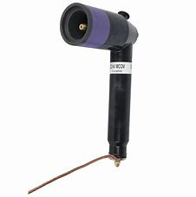
Disadvantages of Ferroresonance
Overheating
Reduced Equipment Lifespan
Arrestor Failures
Notes:
Instances of Ferroresonance can cause extreme overvoltages of several per unit. As a result, current carrying cable and customer secondary equipment may be severely damaged. The capacitors in the padmount transformer itself may be overvoltaged, causing the oil in the capacitors to pressurize and explode! The arrestors on the transformer will also fail. These devices are rated specifically for the voltage of the line, so any extreme fluctuations and the arrestors will fail (simulating a lightning strike). EPRI (Electric Power Research Institute) states that unchecked voltages can exceed 400% of nominal line-ground.

Slide 14
References
Timothy Brammer (Appalachian Power Company)
Valverde, Mazon, Zamora, Buigues, “Ferroresonance in Voltage Transformers”
Baitch, “Theory and Practice of Ferroresonance Due To The Single-Phase Switching Of Distribution Transformers”
Baitch, “Ferroresonance- its Occurrence and Control in Electricity Distribution Networks”
S. J. Kruger and J. A. de Kock, "Ferroresonance: A Review of the Phenomenon and Its Effects,"
EPRI: “Hotline Call of the Month: Ferroresonance in Grounded-Wye/Wye Transformers”

